Slide 1

Submitted by:-
Padmini Komma
Under the Guidance of :-
Rohit sutare

Slide 2

INTRODUCTION
Banking refers to a financial activity to manage and safeguard your hard-earned money.
Banks cater to all sorts of individuals, small businesses and large corporations.
The Banking services is a web based application intended for online users
The main objective of this application is to make it interactive and its ease to use.

Slide 3
PROJECT OBJECTIVE
The main objective of banking services is to manage the details of Accounts, internet banking, transactions, balance enquiry, statements etc.
Making payment simpler just with the mobile number of the beneficiary.
We can monitor your accounts whenever we want.
Check balances on accounts and view records of your transactions and transfer funds.

Slide 4



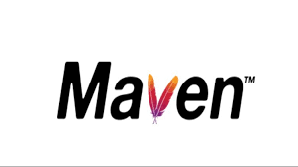


TECHNOLOGIES USED

Slide 5
REQUIRED SPECIFICATION
Hardware configuration | Software configuration
System: 64 – bit operating system RAM : 4GB Hard Disk : 1TB Operating system: Windows 10 | Software IDE : Spring Tool Suite Language : Java Back end : My SQL

Slide 6
PROPOSED SYSTEM
The Proposed system ensures the complete freedom for users. where user at his own system can log on to this website and can use services. Our proposed system allows users to explore services, view .
In this proposal the entire work is Where user can transfer funds , check balance , deposit amount , with drawl amount.

Slide 7

Advantages
Easy to use.
Bank accounts can help you access credit.
Safely storing the public’s wealth.
Easy and economical transfer of funds.
Cheap remittance facilities.
Uniform interest rates.
Tracking account & checking balances.

Slide 8
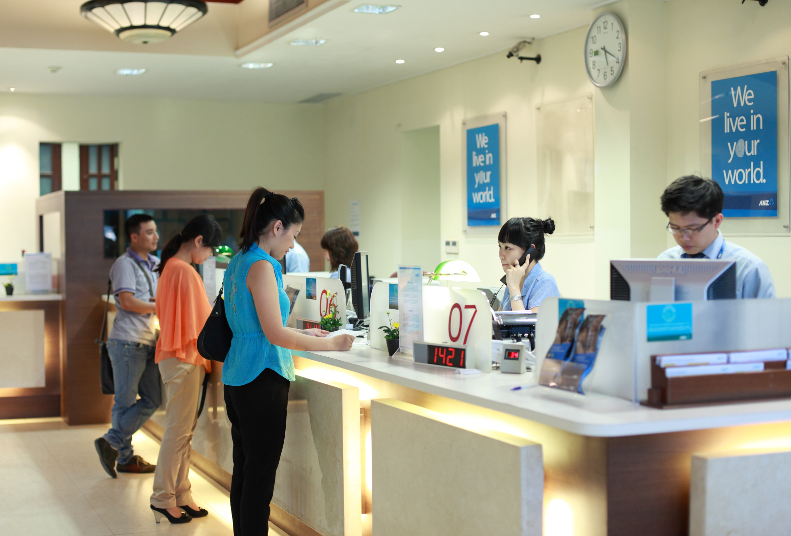
SERVICES
Deposit
With drawl
Delete
View
Check Balance

Slide 9

Future Scope
The scope of this project is as follows
Consumers’ growing desire to access financial services from digital channels has led to a surge in new banking technologies that are reconceptualizing the banking industry.
Digitalization is changing how people interact and do business on a day-to-day basis, and advancements in banking technology are continuing to influence the future of financial services around the world. An increasing demand for a digital banking experience
Mobile banking has become the go-to method for users to make deposits, account transfers, and monitor their spendings and earnings—and a key differentiator for banking leaders. Nearly 80% of our survey respondents who have used mobile banking say it is the primary way they access their bank account.
Online banking, which includes mobile banking, refers to the overall experience of banking through digital channels, including mobile apps, desktop, live chatbots, and more.

Slide 10
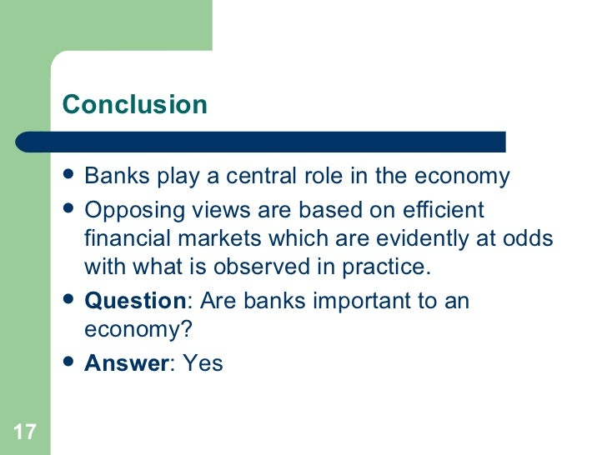

Slide 11


